Slide 1
Computer Science Camp December 2015
Welcome!
Art Simon
Lowell High School
San Francisco, CA
simart@gmail.com
(510) 289-2945

Slide 2
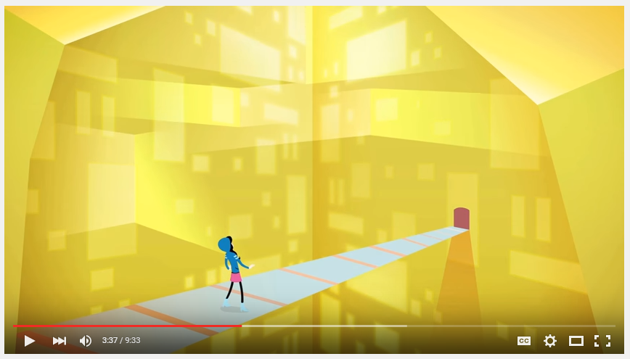
What is Computer Science?
https://www.youtube.com/watch?v=dU1xS07N-FA

Slide 3
What you’ll learn
How to make computer programs using Java, the language used in Advanced Placement Computer Science
How to put your program on a webpage and share it using GitHub
How to format your webpage using a little bit of html and css
How to program Arduinos, the microcontroller used in robotics
How to make wearable electronics using Arduinos

Slide 4
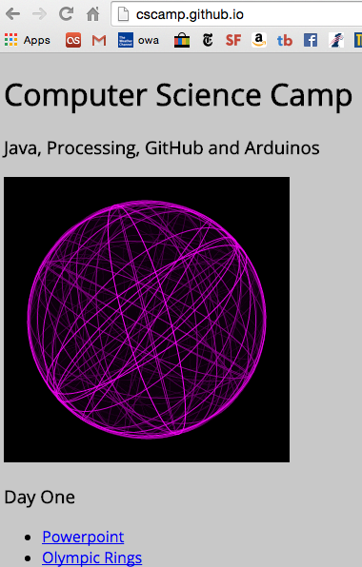
CSCamp.github.io
All the information for the camp is available on our GtiHub site

Slide 5


We’ll be using free software called Processing available at processing.org
We’ll also need a free account at GitHub.com, which is sort of google docs for computer programmers
Then we will work on four different programs and put them up on GitHub:
Olympic Rings
Penguin
Functions and Animation
User Input

Slide 6
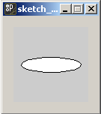
How to make your own computer software
Start Processing
Type ellipse(50,50,80,20);
Press "Run"
You should see this:

Slide 7
How to make your own computer software
ellipse(50,50,80,20);
An example of a function
functions "do something" this one "draws an ellipse with this size and position"
The numbers are called arguments or parameters

Slide 8
Coordinates in Computer Graphics
In computer graphics, the coordinate system is only positive.
The origin is the top left corner of the window
(0,0)
+ X
+ Y

Slide 9
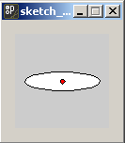
ellipse(50,50,80,20);
The first two arguments (in Red) are the x and y coordinates of the center of the ellipse
50
50

Slide 10
ellipse(50,50,80,20);
The third argument (in Yellow) is the width of the ellipse
The fourth argument (in Green) is the height
If the width and height are the same, the result is a circle
80
20

Slide 11
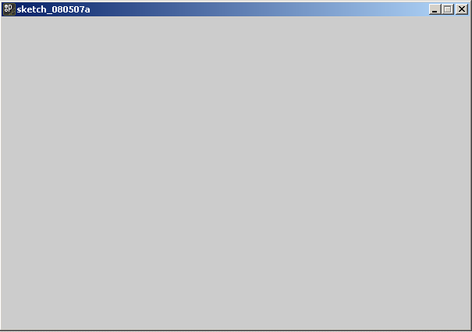
size(300,200);
Another function, should always be called first
This one increases (or decreases) the screen area
The two arguments are width and height
Keep your applets small, no bigger than 800x600, and usually smaller

Slide 12
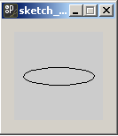
How to make your own computer software
noFill();
ellipse(50,50,80,20);
A program can use any number of functions
The noFill() function changes how ellipses are drawn
Notice that noFill() has no arguments, it's parenthesis are empty

Slide 13
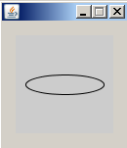
How to make your own computer software
noFill();
smooth();
ellipse(50,50,80,20);
smooth() also has no arguments
It smoothes out the curves of the ellipse

Slide 14
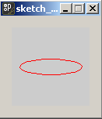
How to make your own computer software
noFill();
stroke(255,0,0);
ellipse(50,50,80,20);
The stroke() function changes the color of the outline
It's 3 arguments are the amount of Red, Green and Blue in the range 0 - 255

Slide 15
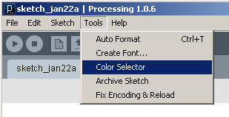
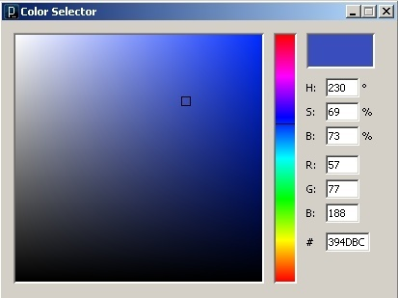
The Color Selector: click on the color you want and read the RGB values

Slide 16
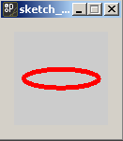
How to make your own computer software
noFill();
stroke(255,0,0);
strokeWeight(5);
ellipse(50,50,80,20);
The strokeWeight() function changes the thickness of the outline

Slide 17
Order is important
ellipse(50,50,80,20);
noFill();
stroke(255,0,0);
strokeWeight(5);
Here changing the stroke and fill has no effect, because it's done after the ellipse had already been drawn

Slide 18
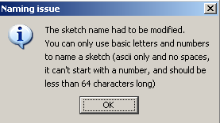
Java is very picky about names
You may get this error message:

Slide 19
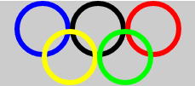
Program #1: Olympic Rings
Write a program that produces a design similar to the Olympic Rings with 5 differently colored circles
Your program will use the following functions (some more than once):
strokeWeight();
stroke()
ellipse()
size()
noFill()

Slide 20
Common Mistakes
Put each statement on a separate line.
Once you call noFill(), from then on, all ellipses will be unfilled. Don't call it more than once.
Same with smooth() and strokeWeight(). Don't call them more than once.

Slide 21
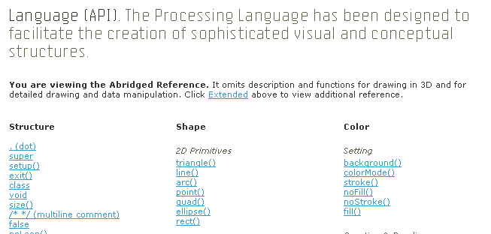
The Processing "Dictionary"
http://processing.org/reference/index.html
The API* is the dictionary of a computer language
* API stands for Application Programming Interface, but you don't really care and it won't be on the test

Slide 22
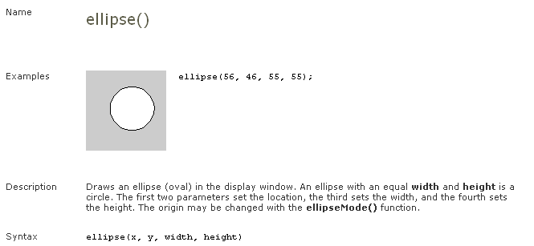
The "definition" of ellipse()

Slide 23
Drawing Functions
triangle()
rect() (also squares)
quad()
ellipse() (also circles)
point()
line()
bezier()and arc() (for curves)
beginShape()and endShape() (for polygons)

Slide 24
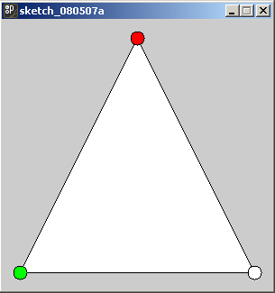
triangle(150,20,20,280,280,280);

Slide 25
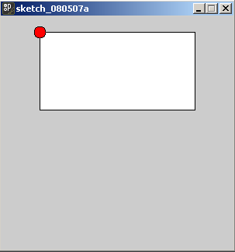
rect(50,20,200,100);

Slide 26
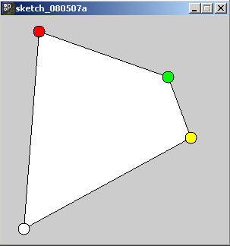
quad(50,20,220,80,250,160,30,280);

Slide 27
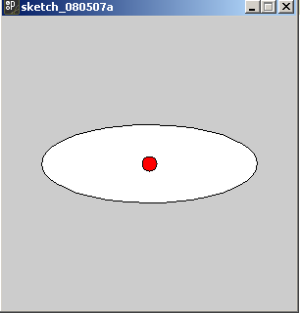
ellipse(150,150,220,80);

Slide 28
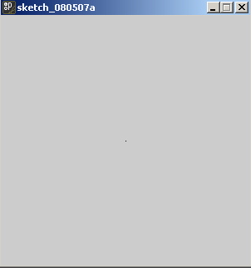
point(150,150);

Slide 29
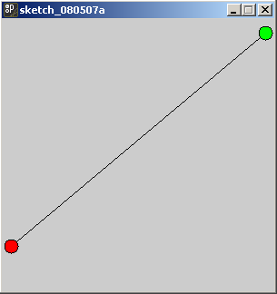
line(10,250,290,15);

Slide 30
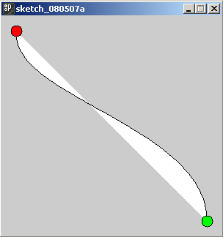
The endpoints
bezier(20,20,10,110,280,150,280,280);

Slide 31
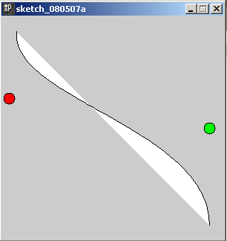
These two invisible points "pull" the curve
bezier(20,20,10,110,280,150,280,280);

Slide 32
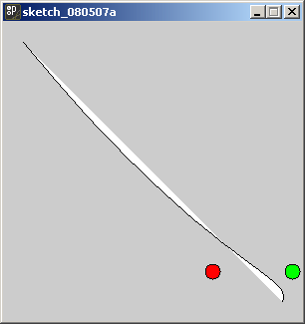
The effect at the ends is weaker
bezier(20,20,210,250,290,250,280,280);

Slide 33
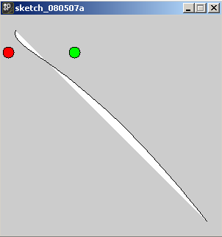
The effect at the ends is weaker
bezier(20,20,10,50,100,50,280,280);

Slide 34
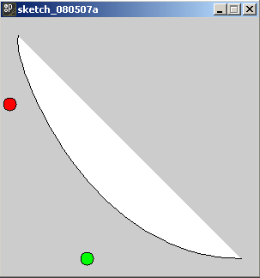
Both points on the same side
bezier(20,20,10,50,100,280,280,280);

Slide 35
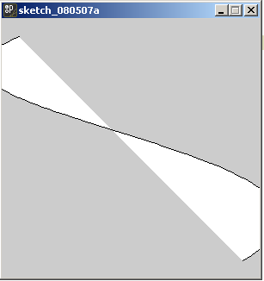
The points can be off the screen!
bezier(20,20,-200,110,500,150,280,280);

Slide 36
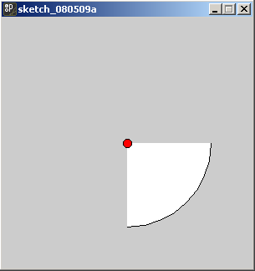
arc() draws part of an ellipse()
arc(150, 150, 200, 200, 0, PI/2);

Slide 37
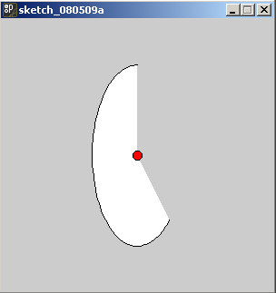
arc() draws part of an ellipse()
arc(150, 150, 100, 200, PI/4, 3*PI/2);

Slide 38
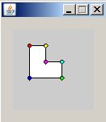
Polygons
beginShape();
vertex(20, 20);
vertex(40, 20);
vertex(40, 40);
vertex(60, 40);
vertex(60, 60);
vertex(20, 60);
endShape(CLOSE);

Slide 39
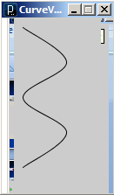
curveVertex
size(100,200);
noFill();
beginShape();
curveVertex(10,10);
curveVertex(10,10);
curveVertex(60,50);
curveVertex(10,90);
curveVertex(60,130);
curveVertex(10,170);
curveVertex(10,170);
endShape();

Slide 40
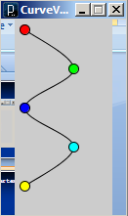
curveVertex
size(100,200);
noFill();
beginShape();
curveVertex(10,10);
curveVertex(10,10);
curveVertex(60,50);
curveVertex(10,90);
curveVertex(60,130);
curveVertex(10,170);
curveVertex(10,170);
endShape();

Slide 41
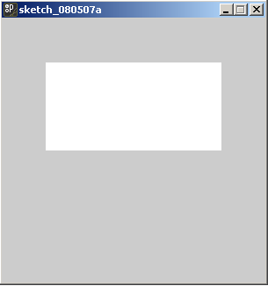
noStroke(); rect(50,50,200,100);

Slide 42
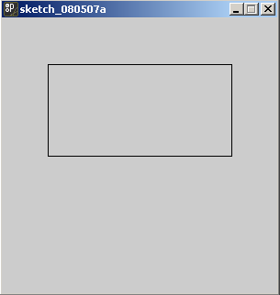
noFill(); rect(50,50,200,100);

Slide 43
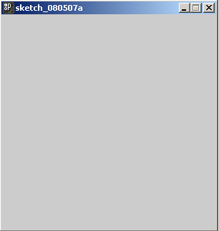
noFill(); noStroke(); rect(50,50,200,100);
Empty!

Slide 44
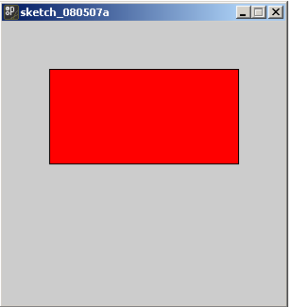
fill(255,0,0); rect(50,50,200,100);

Slide 45
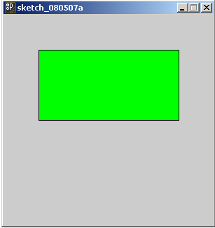
fill(0,255,0); rect(50,50,200,100);

Slide 46
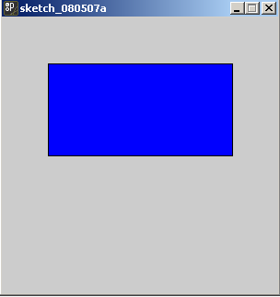
fill(0,0,255); rect(50,50,200,100);

Slide 47
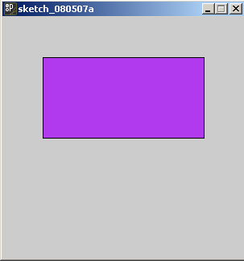
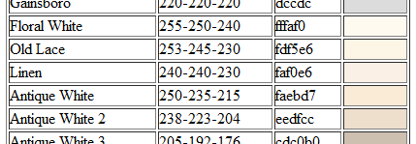
fill(178,58,238); rect(50,50,200,100); RGB Color Codes: http://www.tayloredmktg.com/rgb/

Slide 48
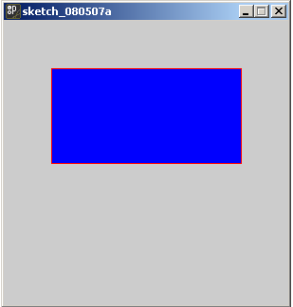
fill(0,0,255); stroke(255,0,0); rect(50,50,200,100);

Slide 49
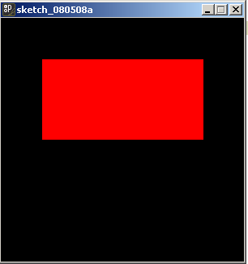
background(0,0,0); fill(255,0,0); rect(50,50,200,100);

Slide 50
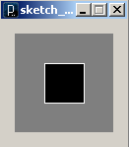
Grayscale
There are one argument versions of fill() and stroke() that give grayscale colors.
background(127); fill(0);
stroke(255); rect(30,30,40,40);
The default background is 204

Slide 51
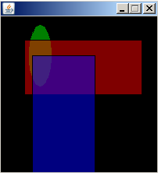
opacity
You can make shapes transparent by using the four argument version of fill()
the fourth argument is opacity
size(200,200);
background(0);
fill(0,255,0,127);
ellipse(50,50,30,80);
fill(255,0,0,127);
rect(30,30,150,70);
fill(0,0,255,127);
rect(40,50,80,170);

Slide 52
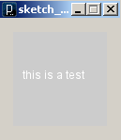
text("this is a test",10,50);

Slide 53
stroke(0); //no effect! text("this is a test",10,50);

Slide 54
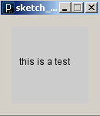
fill(0); text("this is a test",10,50);

Slide 55
textAlign(CENTER); text("this is a test",50,50);

Slide 56
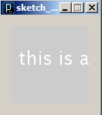
textSize(24); text("this is a test",10,50);

Slide 57
Don't use spaces in Java names
Java won't allow you to put spaces in the name of functions or programs
It's also a bad idea to use spaces in file names

Slide 58
Instead use CamelCase
CamelCase is a style of writing without spaces
It's "good style" to use CamelCase for names in Java
Each separate word in the name is capitalized within the compound—as in beginShape(), endShape(), MacGyver, or iPod.
It's named after the "humps" of the capitals

Slide 59
Comments
Two forms: Single and Multi-line
// Single Line
/* Multi-Line */
Tells the computer "ignore this", this is for people
Good Style: Always put your name, assignment , class and url in comments at the top of your program

Slide 60
Arithmetic
Calculations use the following arithmetic operators: + - * / %
The operators can be combined with numbers to make expressions.
The expression 5 + 3 evaluates to 8
Parenthesis can be used to create more complicated expressions
(5 * (2 – 3)) evaluates to -5

Slide 61
Expressions can be arguments
What will be the height and width of the following ellipse?
ellipse(150,150,2*(22+78),40*(8-2));

Slide 62
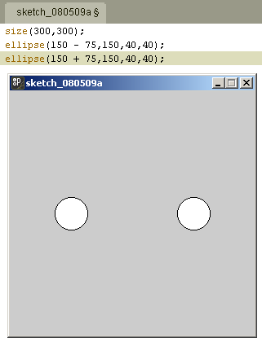
Symmetry
Expressions can be used to make placing symmetrical arrangements easier

Slide 63
Symmetry
size(300,300);
ellipse(150-75,150,40,40);
ellipse(150+75,150,40,40);

Slide 64
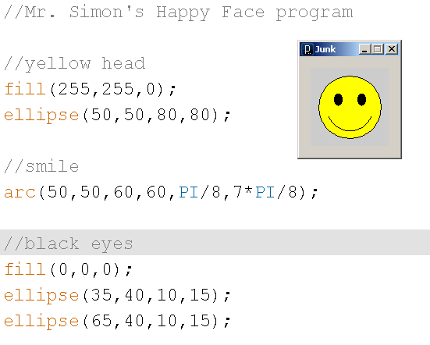
Comments can be used to organize the parts of your program

Slide 65
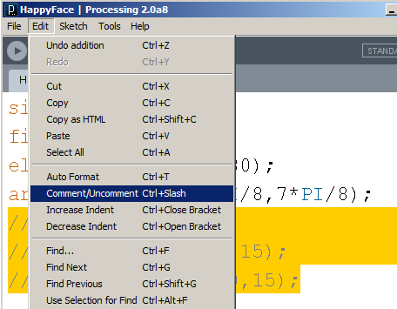
Commenting out code
It’s easy to forget what some code is doing
It’s best to focus on one thing at a time
You can temporarily remove code with Edit | Comment/Uncomment or Ctrl+/

Slide 66
Variables and Declarations
Sometimes you want a place to store a number in computer memory.
You can think of this as a "mailbox"
There different sizes of "mailboxes" for different kinds of numbers.
Integers: int
Decimals: float
Characters (Letters, Punctuation & Digits): char
boolean holds only true or false

Slide 67
Variables and Declarations
Vari-ables allow values to change

Slide 68
Variable Declarations & Initializations
To create a mailbox, you declare it.
int num;
num is the "name" of the variable
names can't have spaces or unusual characters
Once its declared you can store a number in it
num = 5;
This is called initializing
You can also do both at once
int value = 17;

Slide 69
Using variables in expression
Once a variable has been declared and initialized, you can use it in an expression
What will be the x and y coordinates of the center of the ellipse?
int value1 = 17;
int value2 = 13;
ellipse(50+value1,50-value2,12,44);

Slide 70
The assignment operator
= is called the assignment operator
It takes the value on the right, and puts it in the variable on the left
num = 5;
You can't do it the other way around!
5 = num;

Slide 71
The assignment operator
You can't do an assignment as an argument
ellipse(int x = 45,55,10,10);
You have to do in two separate lines
int x = 45;
ellipse(x,55,10,10);

Slide 72


The type of variable must match
You can't put a decimal in an int
Otherwise you'll get an error message

Slide 73
The assignment operator
This looks weird if you are use to algebra, but it's very common in programming
int x = 3;
x = x + 1;
What value is in the x variable after those two lines of code are executed?

Slide 74

Variables can be reused as many times as you like

Slide 75

Now With just one change. . .

Slide 76

"Moving" a circle
size(200,100);
int x = 50;
int y = 50;
ellipse(x,y,60,60);

Slide 77
"Moving" a circle
size(200,100);
int x = 50;
int y = 50;
ellipse(x,y,60,60);
x = x + 50;

Slide 78

"Moving" a circle
size(200,100);
int x = 50;
int y = 50;
ellipse(x,y,60,60);
x = x + 50;
ellipse(x,y,60,60);

Slide 79
"Moving" a circle
size(200,100);
int x = 50;
int y = 50;
ellipse(x,y,60,60);
x = x + 50;
ellipse(x,y,60,60);
x = x + 50;

Slide 80

"Moving" a circle
size(200,100);
int x = 50;
int y = 50;
ellipse(x,y,60,60);
x = x + 50;
ellipse(x,y,60,60);
x = x + 50;
ellipse(x,y,60,60);

Slide 81

Notice the difference?
size(200,100);
int x = 50;
int y = 50;
ellipse(x,y,60,60);
x = x + 50;
ellipse(x,y,60,60);
x = x + 50;
ellipse(x,y,60,60);

Slide 82
The top picture drew the left circle first, while the bottom drew the left circle last
size(200,100);
int x = 50;
int y = 50;
ellipse(x,y,60,60);
x = x + 50;
ellipse(x,y,60,60);
x = x + 50;
ellipse(x,y,60,60);

Slide 83
The bottom picture doesn't match the output of this program
size(200,100);
int x = 50;
int y = 50;
ellipse(x,y,60,60);
x = x + 50;
ellipse(x,y,60,60);
x = x + 50;
ellipse(x,y,60,60);

Slide 84






Find the matching output
size(100,100);
int x = 50;
int y = 50;
ellipse(x,y,60,60);
x = x + 30;
ellipse(x,y,60,60);
y = y - 30;
ellipse(x,y,60,60);
B
A
C
D
E
F

Slide 85
You wouldn't write a paper that was just one long paragraph
You'd have many paragraphs, each of which would focus on one topic
It's the same in programs—we divide our program into chunks called functions
Each function focuses on one job or task

Slide 86
Creating your own functions
Processing allows you to separate your program into different functions.
This is one of the key elements of good style, and makes programs easier to understand, modify and reuse.
A well designed function should do one thing; that is you should be able to describe what it does without using the word and or or.

Slide 87
setup() and draw()
Processing programs that use functions must contain two special functions called setup() and draw()
Put things that happen only once at the beginning in setup()
Put code that draws in draw()
You may create as many additional functions as you want

Slide 88

Happy Face Example
Let's say I had a program that drew a happy face

Slide 89

Happy Face Example
Here's what it would look like separated into setup() and draw() functions
void setup()
{
size(200,100);
}
void draw()
{
fill(255,255,0);
ellipse(100,50,80,80);
arc(100,50,60,60,PI/8,7*PI/8);
fill(0,0,0);
ellipse(85,40,10,15);
ellipse(115,40,10,15);
}

Slide 90
The syntax of functions
void setup()
{
size(200,100);
}
For now, every function starts with void which marks the beginning of the head
Then a name followed by parenthesis
Curly braces mark the beginning and ending of the body of the function
The head and body together are called the function definition

Slide 91

Happy Face Example
Here I've added my own face() and head() functions
void setup()
{
size(200,100);
}
void draw()
{
head();
face();
}
void head()
{
fill(255,255,0);
ellipse(100,50,80,80);
}
void face()
{
arc(100,50,60,60,PI/8,7*PI/8);
fill(0,0,0);
ellipse(85,40,10,15);
ellipse(115,40,10,15);
}

Slide 92

Oops! What happened?
void setup()
{
size(200,100);
}
void draw()
{
face();
head();
}
void head()
{
fill(255,255,0);
ellipse(100,50,80,80);
}
void face()
{
arc(100,50,60,60,PI/8,7*PI/8);
fill(0,0,0);
ellipse(85,40,10,15);
ellipse(115,40,10,15);
}

Slide 93


Auto Format
before
after
Ctrl T is the keyboard shortcut for Auto Format

Slide 94
Simple Animation
We can take advantage of the way setup() and draw() work to create simple animations
(demo)

Slide 95

loops make things repeat
Looping means repeating over and over
If you wanted to display 10 circles to the screen, you could copy and paste code like this:
noFill();
ellipse(5,50,50,50);
ellipse(15,50,50,50);
ellipse(25,50,50,50);
ellipse(35,50,50,50);
ellipse(45,50,50,50);
ellipse(55,50,50,50);
ellipse(65,50,50,50);
ellipse(75,50,50,50);
ellipse(85,50,50,50);
ellipse(95,50,50,50);

Slide 96
Loops
On the other hand, if you wanted to display100 or 1000 or even more circles to the screen, using copy and paste would be tedious
A much better way is to use a loop

Slide 97
while Loops
The simplest loop in java is the while loop
It uses a variable to keep track of how many repetitions to make
The variable has a starting point, an ending point, and some way of progressing from start to end

Slide 98
what is changing?
Each of the circles are identical except for one small change – each circle has a different x coordinate
noFill();
ellipse(5,50,50,50);
ellipse(15,50,50,50);
ellipse(25,50,50,50);
ellipse(35,50,50,50);
ellipse(45,50,50,50);
ellipse(55,50,50,50);
ellipse(65,50,50,50);
ellipse(75,50,50,50);
ellipse(85,50,50,50);
ellipse(95,50,50,50);

Slide 99
To store a changing value use a variable
We could make a variable for the changing x coordinate
noFill();
int x = 5;
ellipse(x,50,50,50);
x = x + 10;
ellipse(x,50,50,50);
x = x + 10;
ellipse(x,50,50,50);
//and so on. . .

Slide 100
Here it is with a while loop
This is the entire program!
noFill();
int x = 5;
while(x < 96)
{
ellipse(x,50,50,50);
x = x + 10;
}

Slide 101
Starting, stopping and progressing
This is the entire program!
noFill();
int x = 5;
while(x < 96)
{
ellipse(x,50,50,50);
x = x + 10;
}

Slide 102
How many ellipses will this program make?
int y = 25;
while(y < 76)
{
ellipse(50,y,25,25);
y = y + 25;
}

Slide 103

How many ellipses will this program make?
int y = 25;
while(y < 76)
{
ellipse(50,y,25,25);
y = y + 25;
}

Slide 104

Here’s a pattern of ellipses of different widths
size(300,300);
background(0);
smooth();
noFill();
stroke(240,20,229,175);
int w = 0;
while(w < 300)
{
ellipse(150,150,w,100);
w = w + 10;
}

Slide 105
How many lines will this program make?
int x = 10;
while(x < 91)
{
line(x,0,x,100);
x = x + 10;
}

Slide 106

How many lines will this program make?
int x = 10;
while(x < 91)
{
line(x,0,x,100);
x = x + 10;
}

Slide 107
What’s this program going to do?
int x = 0;
while(x < 100)
{
line(x,0,x,100);
x = x + 1;
}

Slide 108

What’s this program going to do?
int x = 0;
while(x < 100)
{
line(x,0,x,100);
x = x + 1;
}

Slide 109
We can extend this idea of filling the screen with different lines to make a gradient
(demo)

Slide 110

A program that uses a loop to make a gradient in the background
size(256,256);
int redAmount = 0;
int blueAmount = 255;
int x = 0;
while(x < 256)
{
stroke(redAmount,0,blueAmount);
line(x,0,x,255);
x = x + 1;
redAmount = redAmount + 1;
blueAmount = blueAmount - 1;
}

Slide 111
We can have additional variables to x change as well
size(256,256);
int redAmount = 0;
int blueAmount = 255;
int x = 0;
while(x < 256)
{
stroke(redAmount,0,blueAmount);
line(x,0,x,255);
x = x + 1;
redAmount = redAmount + 1;
blueAmount = blueAmount - 1;
}

Slide 112
Watch out for this mistake!
int x = 0;
while(x < 100);
{
line(x,0,x,100);
x = x + 1;
}

Slide 113
Not a complete sentence
int x = 0;
while(x < 100);
{
line(x,0,x,100);
x = x + 1;
}

Slide 114





Practice quiz question Find the output
int numCircles = 1;
while(numCircles < 5)
{
ellipse(50,numCircles * 20,30,40);
numCircles = numCircles + 1;
}
A
B
C
D
E

Slide 115




Practice quiz question Find the output
A
noFill();
int mystery = 10;
while( mystery < 100)
{
ellipse(50,50,mystery,mystery);
mystery = mystery + 10;
}
B
C
D

Slide 116

Symmetry in a loop
noFill();
int h = 10;
int offset = 0;
while(offset < 100)
{
ellipse(50 - offset,50,10,h);
ellipse(50 + offset,50,10,h);
h = h + 3;
offset = offset + 5;
}

Slide 117
Notice that offset is "in charge" of the loop and h is "along for the ride"
noFill();
int h = 10;
int offset = 0;
while(offset < 100)
{
ellipse(50 - offset,50,10,h);
ellipse(50 + offset,50,10,h);
h = h + 3;
offset = offset + 5;
}

Slide 118

Reversing a loop
This loop positions the x coordinates at 10, 20, 30, 40, 50, 60, 70, 80 and 90
int x = 10;
while(x < 91)
{
ellipse(x,50,20,20);
x = x + 10;
}

Slide 119

Reversing a loop
How would I make this pattern with the x coordinates at 90, 80, 70, 60, 50, 40, 30, 20 and 10?
int x = ??;
while(x ??)
{
ellipse(x,50,20,20);
x = x ??;
}

Slide 120
Reversing a loop
How would I make this pattern with the x coordinates at 90, 80, 70, 60, 50, 40, 30, 20 and 10?
int x = 90;
while(x ??)
{
ellipse(x,50,20,20);
x = x ??;
}

Slide 121
Reversing a loop
How would I make this pattern with the x coordinates at 90, 80, 70, 60, 50, 40, 30, 20 and 10?
int x = 90;
while(x > 9)
{
ellipse(x,50,20,20);
x = x ??;
}

Slide 122
Reversing a loop
How would I make this pattern with the x coordinates at 90, 80, 70, 60, 50, 40, 30, 20 and 10?
int x = 90;
while(x > 9)
{
ellipse(x,50,20,20);
x = x - 10;
}

Slide 123
A loop within a loop
How many ellipses will this program make?
int y = 20;
while (y < 81)
{
ellipse(50,y,20,20);
y = y + 30;
}

Slide 124

A loop within a loop
How many ellipses will this program make?
int y = 20;
while (y < 81)
{
ellipse(50,y,20,20);
y = y + 30;
}

Slide 125
A loop within a loop
int x = 20;
while(x < 81)
{
int y = 20;
while (y < 81)
{
ellipse(x,y,20,20);
y = y + 30;
}
x = x + 30;
}
Now, what if we put that loop inside another loop ? How many ellipses would we get?

Slide 126

A loop within a loop
int x = 20;
while(x < 81)
{
int y = 20;
while (y < 81)
{
ellipse(x,y,20,20);
y = y + 30;
}
x = x + 30;
}

Slide 127

A loop within a loop
int x = 20;
while(x < 81)
{
int y = 20;
while (y < 81)
{
line(x,y,50,50);
y = y + 30;
}
x = x + 30;
}
I’ve changed it to make 9 lines

Slide 128

A loop within a loop
int x = 20;
while(x < 81)
{
int y = 20;
while (y < 81)
{
line(x,y,50,50);
y = y + 6;
}
x = x + 6;
}
Now how many lines?

Slide 129
A loop within a loop
int x = 20;
while(x < 81)
{
int y = 20;
while (y < 81)
{
line(x,y,50,50);
y = y + 6;
}
x = x + 6;
}
121!

Slide 130
Rotatations
You can use rotate() and translate() to rotate shapes, but it's very confusing
You will NOT be tested on rotate() and translate()

Slide 131

Rotatations
ellipse(50,50,80,20);

Slide 132

Rotatations
rotate(PI/4);
ellipse(50,50,80,20);

Slide 133

Rotatations
translate(50,50);
rotate(PI/4);
ellipse(50,50,80,20);

Slide 134

Rotatations
translate(50,50);
rotate(PI/4);
ellipse(0,0,80,20);

Slide 135

Rotatations
translate(50,50);
rotate(PI/4);
ellipse(0,0,80,20);
ellipse(50,50,80,20);

Slide 136

Rotatations
translate(50,50);
rotate(PI/4);
ellipse(0,0,80,20);
rotate(-PI/4);
translate(-50,-50);
ellipse(50,50,80,20);

Slide 137

Oops! Colors must stay between 0 & 255
size(300, 300);
int white = 0;
int x = 0;
while (x < 300)
{
stroke(white);
line(x, 0, x, 300);
white = white + 1;
x = x + 1;
}

Slide 138

A "scaled" gradient
size(300, 300);
float white = 0;
int x = 0;
while (x < 300)
{
stroke(white);
line(x, 0, x, 300);
white = white + 255.0/300.0;
x = x + 1;
}

Slide 139

Fade from Sea Green 46-164-87 to Sandy Brown 244-139-96
size(300,200);
float r = 46;
float g = 164;
float b = 87;
int x = 0;
while(x < 300)
{
stroke(r,g,b);
line(x,0,x,200);
x = x + 1;
r = r + (244-46)/300.0;
g = g + (139-164)/300.0;
b = b + (96-87)/300.0;
}

Slide 140
Modern programs are very big—they are organized into Functions
Year | Operating System | Lines of Code
1993 | Windows NT 3.1 | 6,000,000
1996 | Windows NT 4.0 | 16,000,000
2000 | Windows 2000 | 29,000,000
2001 | Windows XP | 40,000,000
2005 | Windows Vista Beta 2 | 50,000,000
2005 | Mac OS X 10.4 | 86,000,000
2005 | Red Hat Linux 7.1 | 30,000,000
2005 | Debian GNU/Linux | 213,000,000
Programs can be difficult to understand Windows Vista has over 50,000,000 lines of computer code!
One way to make programs easier to understand is to break them down into smaller "chunks" or modules
One name for these modules is functions

Slide 141
You wouldn't write a paper that was just one long paragraph
You'd have many paragraphs, each of which would focus on one topic
It's the same in programs—we divide our program into chunks called functions
Each function focuses on one job or task

Slide 142
Creating your own functions
Processing allows you to separate your program into different functions.
This is one of the key elements of good style, and makes programs easier to understand, modify and reuse.
A well designed function should do one thing; that is you should be able to describe what it does without using the word and or or.

Slide 143
setup() and draw()
Processing programs that use functions must contain two special functions called setup() and draw()
Put things that happen only once at the beginning in setup()
Put code that draws in draw()
You may create as many additional functions as you want

Slide 144
Happy Face Example
Let's say I had a program that drew a happy face

Slide 145
Happy Face Example
Here's what it would look like separated into setup() and draw() functions
void setup()
{
size(200,100);
}
void draw()
{
fill(255,255,0);
ellipse(100,50,80,80);
arc(100,50,60,60,PI/8,7*PI/8);
fill(0,0,0);
ellipse(85,40,10,15);
ellipse(115,40,10,15);
}

Slide 146
The syntax of functions
void setup()
{
size(200,100);
}
For now, every function starts with void which marks the beginning of the head
Then a name followed by parenthesis
Curly braces mark the beginning and ending of the body of the function
The head and body together are called the function definition

Slide 147
Happy Face Example
Here I've added my own face() and head() functions
void setup()
{
size(200,100);
}
void draw()
{
head();
face();
}
void head()
{
fill(255,255,0);
ellipse(100,50,80,80);
}
void face()
{
arc(100,50,60,60,PI/8,7*PI/8);
fill(0,0,0);
ellipse(85,40,10,15);
ellipse(115,40,10,15);
}

Slide 148
Oops! What happened?
void setup()
{
size(200,100);
}
void draw()
{
face();
head();
}
void head()
{
fill(255,255,0);
ellipse(100,50,80,80);
}
void face()
{
arc(100,50,60,60,PI/8,7*PI/8);
fill(0,0,0);
ellipse(85,40,10,15);
ellipse(115,40,10,15);
}

Slide 149
Auto Format
before
after
Ctrl T is the keyboard shortcut for Auto Format

Slide 150
Simple Animation
We can take advantage of the way setup() and draw() work to create simple animations
(demo)

Slide 151
Function Definitions
Function definitions describe how the function will work when you use it
void setup()
{
size(200,100);
}
void draw()
{
head();
face();
}
void face()
{
arc(100,50,60,60,PI/8,7*PI/8);
fill(0,0,0);
ellipse(85,40,10,15);
ellipse(115,40,10,15);
}
void head()
{
fill(255,255,0);
ellipse(100,50,80,80);
}

Slide 152
Function calls
The function call causes the code to run
Notice that the order of the function definitions isn’t important, rather, the order you call the functions is what matters
void setup()
{
size(200,100);
}
void draw()
{
head();
face();
}
void face()
{
arc(100,50,60,60,PI/8,7*PI/8);
fill(0,0,0);
ellipse(85,40,10,15);
ellipse(115,40,10,15);
}
void head()
{
fill(255,255,0);
ellipse(100,50,80,80);
}

Slide 153
Input
Most programs we see get input from people
The most common ways people provide input are:
Typing on the keyboard
Moving and/or clicking the mouse

Slide 154
Input
Processing makes input from the mouse and keyboard about as easy as it gets
There are several predefined "system variables"
mouseX
mouseY
key
“Predefined system variables” are variables that Processing has already declared and initialized

Slide 155
Moving a circle with the mouse
void setup()
{
size(300,300);
}
void draw()
{
ellipse(mouseX,mouseY,30,30);
}
The ellipse will track the mouse

Slide 156
Symmetrical reflections (mirrors)
(50,30)
200
300

Slide 157
Symmetrical reflections (mirrors)
(50,30)
50
200
300

Slide 158
Symmetrical reflections (mirrors)
(50,30)
50
50
200
300

Slide 159
Symmetrical reflections (mirrors)
(50,30)
(300-50,30)
50
50
200
300

Slide 160

Symmetrical reflections (mirrors)
void setup()
{
size(300,300);
}
void draw()
{
ellipse(mouseX,mouseY,10,10);
ellipse(300-mouseX,mouseY,10,10);
}

Slide 161

The complete list of input functions and variables is in the API

Slide 162
Painting only if mouse is dragged
void setup()
{
size(300,300);
}
void draw()
{
}
void mouseDragged()
{
ellipse(mouseX,mouseY,10,10);
}

Slide 163
More system variables: pmouseX and pmouseY
mouseX and mouseY hold the current position of the mouse
pmouseX and pmouseY hold the previous position of the mouse

Slide 164

A drawing program
void setup()
{
size(300,300);
}
void draw()
{
stroke(0);
fill(0,0,0,10);
rect(0,0,300,300);
}
void mouseDragged()
{
stroke(255);
line(mouseX,mouseY,pmouseX,pmouseY);
}

Slide 165
Painting only if the right mouse button is clicked
void setup()
{
size(300,300);
}
void draw()
{
}
void mousePressed()
{
if(mouseButton==RIGHT)
{
ellipse(mouseX,mouseY,10,10);
}
}

Slide 166
boolean variables
booleans are the smallest, simplest kind of "mailbox"
They can hold only one of two possible values: true or false
Examples:
boolean zoom = true;
boolean cond = 3 >= 3;
boolean isBig = num > 7;

Slide 167

Logical Operators
&& //AND
|| //OR
! //NOT
Used to combine multiple conditions ("tests")
Truth tables shown at right above
Examples
( 0 < nCount ) && ( nCount <= 100 )
( 0 < nCount ) || ( nCount <= 100 )
(‘A’ <= cGrade) && (cGrade <= ‘F’)
! (19 >= nAge && nAge >= 13)
19 < nAge || nAge < 13

Slide 168
Watch out for this error
if(mousePressed == true);
{
ellipse(mouseX,mouseY,10,10);
}

Slide 169
There shouldn't be a semi-colon here
if(mousePressed == true);
{
ellipse(mouseX,mouseY,10,10);
}

Slide 170
There shouldn't be a semi-colon here
if(mousePressed == true);
{
ellipse(mouseX,mouseY,10,10);
}
Is If mousePressed is true a complete sentence?

Slide 171
Now it's fixed
if(mousePressed == true)
{
ellipse(mouseX,mouseY,10,10);
}
No, the complete sentence is If mousePressed is true draw an ellipse at the position of the mouse.

Slide 172
Random numbers
The random() function has two versions:
random(5) returns a decimal value between 0 and up to but not including 5.0
random(-5, 10.2) returns a decimal value between -5.0 and up to but not including 10.2.
To drop the decimal part of a random number, use the int() function.
int randNum = int(random(6));
randNum now holds an integer from 0 up to but not including 6: {0,1,2,3,4,5}

Slide 173
dice example
Let's say I wanted to make an applet that simulated rolling a single six sided die
What numbers would be possible?

Slide 174
dice example
Let's say I wanted to make an applet that simulated rolling a single six sided die
What numbers would be possible?
{1,2,3,4,5,6}

Slide 175
dice example
Let's say I wanted to make an applet that simulated rolling a single six sided die
What numbers would be possible?
{1,2,3,4,5,6}
int roll = ??

Slide 176
dice example
Let's say I wanted to make an applet that simulated rolling a single six sided die
What numbers would be possible?
{1,2,3,4,5,6}
int roll = int(random(?,?));

Slide 177
dice example
Let's say I wanted to make an applet that simulated rolling a single six sided die
What numbers would be possible?
{1,2,3,4,5,6}
int roll = int(random(?,?));
+1

Slide 178
dice example
Let's say I wanted to make an applet that simulated rolling a single six sided die
What numbers would be possible?
{1,2,3,4,5,6}
int roll = int(random(1,7));
+1

Slide 179
A bug with negative arguments
What arguments would you use to get this range?
{-3,-2,-1,0,1,2,3}
int roll = int(random(?,?));

Slide 180
A bug with negative arguments
For some reason the low limit is one less.
{-3,-2,-1,0,1,2,3}
int roll =int(random(-4,4));
+1
-1

Slide 181
Random Walk
The position or state of an object changes unpredictably (by a random amount) over time
Software uses random walks to model many "real life" things including:
Weather
Stock Prices
Load on a web server
Chemistry (gas particles)
Biology (food foraging)

Slide 182

More Random Walk examples
http://www.mit.edu/~kardar/teaching/projects/chemotaxis(AndreaSchmidt)/random.htm

Slide 184
A Random Walk isn't a Random Jump
I'd call this a random jump
x = int(random(0,400));

Slide 185
A Random Walk isn't a Random Jump
I'd call this a random jump
x = int(random(0,400));
I'd call this a random walk
x = x + int(random(-2,2));

Slide 186

A one-dimensional random walk
The one dimension is the x axis, y doesn't change
int x = 150;
void setup()
{
size(300,100);
}
void draw()
{
background(0);
ellipse(x,50,40,40);
x = x + int(random(-2,2));
}

Slide 187
if and if/else
int num = 5;
if(num > 150)
{
num = 5;
}
An if controls some code that either runs or doesn't
if(num > 150)
{
num = 5;
}
else
{
num = num + 10;
}
An if/else always runs the code in the if or the else, but never both

Slide 188
"Chained" if/else
if(temp > 80)
{
println("Go swimming");
}
else if(temp > 50)
{
println("Go Fishing");
}
else if(temp > 32)
{
println("Go hot tubbing");
}
else
{
println("Go sledding");
}

Slide 189
if vs. if/else
void draw()
{
background(204);
if(int(random(4)) == 0)
{
ellipse(50,50,100,100);
}
if(int(random(4)) == 1)
{
ellipse(150,50,100,100);
}
if(int(random(4)) == 2)
{
ellipse(250,50,100,100);
}
if(int(random(4)) == 3)
{
ellipse(350,50,100,100);
}
}
Here is a program that uses four separate ifs
void setup()
{
size(400,100);
frameRate(2);
}

Slide 190


if vs. if/else
void draw()
{
background(204);
if(int(random(4)) == 0)
{
ellipse(50,50,100,100);
}
if(int(random(4)) == 1)
{
ellipse(150,50,100,100);
}
if(int(random(4)) == 2)
{
ellipse(250,50,100,100);
}
if(int(random(4)) == 3)
{
ellipse(350,50,100,100);
}
}
Every time the screen is drawn I could see any number of ellipses from 0 to 4

Slide 191
if vs. if/else
void draw()
{
background(204);
int num = int(random(4));
if(num == 0)
{
ellipse(50,50,100,100);
}
else if(num == 1)
{
ellipse(150,50,100,100);
}
else if(num == 2)
{
ellipse(250,50,100,100);
}
else
{
ellipse(350,50,100,100);
}
}
Here is a program that uses a chained if/else
void setup()
{
size(400,100);
frameRate(2);
}

Slide 192


if vs. if/else
void draw()
{
background(204);
int num = int(random(4));
if(num == 0)
{
ellipse(50,50,100,100);
}
else if(num == 1)
{
ellipse(150,50,100,100);
}
else if(num == 2)
{
ellipse(250,50,100,100);
}
else
{
ellipse(350,50,100,100);
}
}
Every time the screen is drawn I will see exactly 1 ellipse

Slide 193
Practice Quiz Question: What is the output of this program?
int num1= 2;
int num2 = 7;
float decimal = 9;
if(num1 == 2)
{
println("First");
}
else if (num2 == 3)
{
println("Second");
}
else if (decimal == 9)
{
println("Third");
}
else
{
println("Fourth");
}
if(num2/num1 != 1)
{
println("Fifth");
}
if(num2/num1 != 3)
{
println("Sixth");
}
else
{
println("Seventh");
}

Slide 194

Using Pictures and Images
Processing can display .gif, .jpg, .tga, and .png image
First, choose Sketch | Add File to select the the image you want

Slide 195
Images
Now, write code like this, where hallway.jpg is the name of the picture
PImage b;
void setup()
{
size(415,350);
b = loadImage("hallway.jpg");
}
void draw()
{
image(b, 0, 0,415,350);
}

Slide 196

Using a URL for an image
Another way to load an image into your program is with a URL
Right click on an image that’s on the internet and select Copy image URL

Slide 197

Using a url for an image

Slide 198
Images
b is the name of the variable that holds the image
0,0 is the x and y of the top left hand corner
415,350 is the width and height
PImage b;
void setup()
{
size(415,350);
b = loadImage("hallway.jpg");
}
void draw()
{
image(b, 0, 0 ,415,350);
}

Slide 199
Using an image for the background()
Make sure the size() of the applet is the same as the size of the image.
PImage bill;
void setup()
{
size(450,315);
bill = loadImage("bill-gates-mugshot.jpg");
}
void draw()
{
background(bill);
}

Slide 200

tint()
You can change the color and opacity of an image with the tint function
PImage checkers;
void setup()
{
size(400,400);
checkers =
loadImage("OpArt.JPG");
}
void draw()
{
background(0);
image(checkers,50,
50,152,138);
}

Slide 201

tint()
tint(255,0,0); will give a red tint
PImage checkers;
void setup()
{
size(400,400);
checkers =
loadImage("OpArt.JPG");
}
void draw()
{
background(0);
tint(255,0,0);
image(checkers,50,
50,152,138);
}

Slide 202

tint(255,255,255,130); will give no tint (it's white) but will change the opacity
PImage checkers;
void setup()
{
size(400,400);
checkers =
loadImage("OpArt.JPG");
}
void draw()
{
background(0);
tint(255,255,255,130);
image(checkers,50,
50,152,138);
image(checkers,75,
75,152,138);
}

Slide 203

Adding Sound
To create a program that uses sound, we need to import a library called minim
A library is extra code that other programmers have made available for us to use
import is like “invisibly” cutting and pasting someone else’s code into our program

Slide 204

Adding Sound
Then, we need to add the file that has the sound
It can be a WAV, AIFF, AU, SND, or MP3 file
Choose Sketch | Add File and browse to the file

Slide 205
If the file I just added was mysong.mp3, the following code would play it when the program starts
Minim minim;
AudioPlayer song;
void setup()
{
minim = new Minim(this);
// this loads mysong.mp3 from the data folder
song = minim.loadFile("mysong.mp3");
song.play();
}
void draw(){} //empty for now
void stop()
{
song.close();
minim.stop();
super.stop();
}

Slide 206
Other useful functions
song.play(1000)starts the song from 1000 milliseconds (1 second)
song.rewind()
song.loop() plays the song continuously
song.loop(3) plays the song 3 times
song.setLoopPoints(1000,2000) will set the loop points to 1 second and 2 second
song.pause()

Slide 207

Which dot is moving in a random walk?

Slide 208

Which dot is moving in a random walk?

Slide 209

Which dot is moving in a random walk?

Slide 210

Which dot is moving in a random walk?

Slide 211

Which dot is moving in a random walk?

Slide 212

Which dot is moving in a random walk?

Slide 213

Which dot is moving in a random walk?

Slide 214
Random Walks
In a random walk, you always take one step at a time
You don't take different size random jumps to an entirely new random location
In a random walk, if we leave a trail, there will not be any gaps

Slide 215

A Pacman style random walk
Keeps the objeect moving
Limits movement to up, down, left and right (not diagonal)
Takes a step of a discrete size (always the same number, never zero)

Slide 216
4 possible values {0,1,2,3}
int direction = int(random(0,4));
if(direction == 0)
{
x = x + 20; //right
}
else if(direction == 1)
{
x = x - 20; //left
}
else if(direction == 2)
{
y = y + 20; //down
}
else // direction must be 3
{
y = y - 20; //up
}

Slide 217

The complete program

Slide 218
mousePressed function vs. variable
Processing has both a mousePressed() function and a mousePressed system variable
The thing to remember is that the mousePressed() function will run once every time the mouse is pressed.

Slide 219

If I use the function, I get one ellipse with every press
void setup()
{
size(300,300);
}
void draw()
{
//empty
}
void mousePressed()
{
ellipse(random(300),random(300),30,30);
}

Slide 220

If I use the variable in draw(), I get more ellipses the longer I press
void setup()
{
size(300,300);
}
void draw()
{
if(mousePressed == true)
{
ellipse(random(300),random(300),30,30);
}
}

Slide 221
Moving the ellipse with the keyboard
int x, y;
void setup()
{
size(300,300);
x = 150;
y = 150;
}
void draw()
{
ellipse(x,y,30,30);
}
void keyPressed()
{
if(key == 'w')
{
y = y - 5;
}
}

Slide 222

tron

Slide 223
get()
Returns the color of one pixel
if(get(x,y) != color(0,0,0))
{
//lots of java
}

Slide 224

How we could check for a crash with get()
int x = 10;
int y = 150;
void setup()
{
size(300,300);
background(0);
fill(255);
ellipse(270,150,20,20);
}
void draw()
{
if(get(x,y) != color(0,0,0)) //we crashed!
{
fill(255,0,0);
ellipse(150,150,250,250);
}
else
{
stroke(255,0,255);
point(x,y);
x++;
}
}

Slide 225

How we could check for a crash with get()
int x = 10;
int y = 150;
void setup()
{
size(300,300);
background(0);
fill(255);
ellipse(270,150,20,20);
}
void draw()
{
if(get(x,y) != color(0,0,0)) //we crashed!
{
fill(255,0,0);
ellipse(150,150,250,250);
}
else
{
stroke(255,0,255);
point(x,y);
x++;
}
}

Slide 226
Writing tron
Don't try to write the program all at once
Get one detail working and then move on to the next thing
Let's start by making the light trail

Slide 227

Writing tron
The next thing would be to create an int called direction so we can change our direction

Slide 228

adding code to draw()
Now, we'd probably want to make a keyPressed() function so that we can change direction with the keyboard

Slide 229

Changing direction in keyPressed()

Slide 230

A boolean gameOver variable
Keeping track off whether the game is over is important
One way to do that is with a boolean variable

Slide 231

A boolean gameOver variable
When a player crashes we will change the value of the boolean

Slide 232

A boolean gameOver variable
Once the game is over, we’ll display an appropriate message

Slide 233

Practice Quiz Question: Find the output
background(0);
fill(255,0,0);
ellipse(10,10,10,10);
fill(0,255,0);
ellipse(20,20,10,10);
fill(255);
ellipse(30,30,10,10);
println(get(10,10) != color(0));
println(get(20,20) == color(255));
println(get(30,30) == color(255));
println(get(50,50) != color(0));

Slide 234

Adding a computer opponent
Before I add the computer, let's clean up the code
draw() is getting ugly
let's move the human code into its own function

Slide 235

Adding a computer opponent
There, that's better
Now we can use the human() function as a guide
computer() will be similar

Slide 236

Adding a computer opponent
The computer opponent will need it's own set of variables to keep track of its location and direction

Slide 237

Adding a computer opponent
We will write a function that is very similar to human() called computer()
In computer(), will use compX, compY, etc., instead of x & y

Slide 238
Adding a computer opponent
The problem now is that our computer won't turn
We need to add code to make it "smart"
Sometimes, this is called "AI" for artificial intelligence

Slide 239

Adding a computer opponent
In each of the four if statements of the computer, we will look ahead 1 place to see if we are going to run into something
If we are, we'll turn by changing the value of compDir

Slide 240

Computer programming and
the Arduino microcontroller
*

Slide 241

What is an Arduino?
http://www.youtube.com/watch?v=CqrQmQqpHXc
*

Slide 242
Sparkfun Inventors Kit - SIK
Includes the Arduino, a breadboard, and an instruction manual with 15 projects
We will work through all 15 projects, plus some additional projects
*

Slide 243


The Breadboard
The breadboard lets you make a circuit without soldering
Anything in the same column on the two outer “Power Rails” is connected
The inner sections are connected horizontally
The two halves of the breadboard are separate
*

Slide 244

The First Project – A blinking LED
The Arduino acts like a battery that can turn itself on and off
*

Slide 245

The First Project – A blinking LED
The color of the jumper wires isn’t important, but make sure you have the right resistor
*

Slide 246
The First Project – A blinking LED
The color of the jumper wires isn’t important, but make sure you have the right resistor
*

Slide 247

The First Project – The Code
The Arduino is programmed by uploading code
The code in setup() runs first, one time
Then the code in loop() repeats forever
*

Slide 248


The First Project – The Code
Notice that the code is turning the power on and off to pin 13
*

Slide 249

The First Project – The Code
We can change the code
Here the LED blinks twice, one short, one long
Note that // is a comment and ignored by the Arduino
*

Slide 250
The First Project – A Challenge
How could you modify the code in the first program so that the LED blinks in an SOS pattern?
*

Slide 251

Understanding the code
// are single line comments
/* */ are multi line comments
Comments are used to explain code to people, but not necessary for the program to run
Sometimes it is easier to understand the program if you remove the comments
*

Slide 252

The 2nd Project – A blinking LED with a potientiometer
The potentiometer adjusts the speed of the blinking LED
A potentiometer changes resistance as it is turned
*

Slide 253

The 2nd Project – The Code
This is pretty much the same code as the first project
The new idea here is variables
*

Slide 254
The 2nd Project – The Code
ledPin is an example of a variable
A variable is a place in the computer memory where we can store a value
13 is the value in this example
int ledPin = 13;
void setup()
{
pinMode(ledPin, OUTPUT);
//other code not shown
//is the same as
void setup()
{
pinMode(13, OUTPUT);
*

Slide 255
Variable declarations and initializations
In both C and Java, variable declarations and initializations are important
The declaration says how much memory we need
The initialization assigns the first value to the variable
int ledPin = 13;
*

Slide 256
A C statement is like a sentence
int ledPin = 13;
This statement says “create enough space in memory to store an integer, name it ledPin and then store the value 13 in the space.”
The semi-colon is like a period, it ends the statement
*

Slide 257
The same code written a different way
int ledPin = 13;
Can be written in two statements:
int ledPin;
ledPin = 13;
*

Slide 258
Functions are like paragraphs
Just like English writing is separated in paragraphs, programs are separated into functions
Each function has one job
Arduino rograms can have many functions, but will always have setup() and loop()
*

Slide 259

The 2nd Project – A Challenge
Move the red wire from pin 13 on the Arduino to pin 12
Rewrite the program to use pin 12
*

Slide 260


Serial Monitor
A window that can receive messages from the Arduino
Very useful for troubleshooting and debugging
*

Slide 261

Serial Monitor
Notice the difference when I move the Serial.println() from setup() to loop()
*

Slide 262
Literal
A literal is formed with double quotes
E.g. "Arduino says hello"
*

Slide 263

Expression
An expression does NOT have double quotes
An expression is evaluated
E.g. 2 + 2
*

Slide 264

Double quotes make a big difference
Notice the difference?
*

Slide 265

print() vs. println()
print() prints to the serial monitor window
println() prints AND THEN goes to the next line
*

Slide 266
Spaces and double quotes
If you don’t put any spaces in the double quotes, there won’t be any spaces in the output
*

Slide 267

Spaces and double quotes
Here we’ve added spaces after Arduino and says
*

Slide 268

print() vs. println()
Here we’ve added two println()statements So that the output goes to the next line after “Arduino” and “says”
*

Slide 269

print() vs. println()
You can mix print() and println()anyway you want
*

Slide 270

The 2nd Project – Another Challenge
Use variables to store the long and short blinks
Use the potentiometer to change the variables
*

Slide 271

Practice Quiz
What will be displayed on the Serial Monitor?
*

Slide 272

Danger! Always close the serial monitor window before unplugging the Arduino
If you don’t, you can lock up the Arduino
Ask me how I know
*

Slide 273

The 3rd Project – A blinking multicolor RGB LED
Introduces constants
const int RED_PIN = 9;
Adds 2 more functions to the program in addition to setup() & loop()
mainColors() & showSpectrum()
Introduces for loops
Introduces if statements
*

Slide 274
The 3rd Project – A Challenge
Add an additional function to the program that makes an original pattern
*

Slide 275

The 3rd Project – A Challenge
Note that pins 9, 10 and 11 are connected to the RGB led
*

Slide 276

The 3rd Project – A Challenge
Rather than try and remember that pin 9 controls red, we’ll make a constant const int RED_PIN that is equal to 9
*

Slide 277
Constants must be declared and initialized on the same line
const int RED_PIN = 9;
If you try and do in in two statements like a regular variable, you’ll get an error:
const int RED_PIN;
RED_PIN = 9; //ERROR!
*

Slide 278
The 3rd Project – A Challenge
Since it is a constant, trying to make RED_PIN equal to 8 will generate an error
*

Slide 279

The 3rd Project – A Challenge
First, we’ll write the function definition which starts with void
After void comes the name. You can name it whatever you want
*

Slide 280

The 3rd Project – A Challenge
Add code to the curly braces of your function
Then add a function call to loop()
Notice there is no void in the call
*

Slide 281

Practice Quiz Question
Find the Output
*

Slide 282

Loops
http://code.org/educate/videos
*

Slide 283
SOS Pattern using Loops
Every for loop has a variable
The variable progresses thtough some values that are sometimes called start stop and step
for(int i = 1; i <= 3; i = i + 1)
In this case i will progress from 1 to 3 with a step of 1
*

Slide 284

SOS Pattern using Loops
Here I’ve got a program with two blink functions shortBlink() and longBlink()
*

Slide 285

SOS Pattern using Loops
Now I’ve added three for loops
*

Slide 286
Loops
What would this display?
for(int i = 1; i <= 5; i = i + 1)
{
Serial.println("hello");
}
*

Slide 287

Loops
What would this display?
for(int i = 1; i <= 5; i = i + 1)
{
Serial.println("hello");
}
*

Slide 288
Loops
What would this display?
for(int i = 2; i<=10; i = i + 2)
{
Serial.println("hello");
}
*

Slide 289
Loops
What would this display?
for(int i = 2; i<=10; i = i + 2)
{
Serial.println("hello");
}
*

Slide 290
Loops
What would this display?
for(int i = 3; i <= 6; i++)
{
Serial.println("hello");
}
i++ is the same as i = i + 1
*

Slide 291

Loops
What would this display?
for(int i = 3; i <= 6; i++)
{
Serial.println("hello");
}
*

Slide 292
Loops
What would this display?
for(int i = 3; i <= 6; i++)
{
Serial.println(i);
}
*

Slide 293

Loops
What would this display?
for(int i = 3; i <= 6; i++)
{
Serial.println(i);
}
*

Slide 294

Understanding the code
Here a for loop changes the RGB value of the light
The r variable will repeatedly progress 0,1,2,3….254
After each progression we will delay() for a short time
*

Slide 295
Understanding the code
The RGB values will progress in this pattern
0 0 255
1 0 254
2 0 253
3 0 252
4 0 251
5 0 250
6 0 249
and so on . . .
*

Slide 296
Practice Quiz Question
What would this display?
for(int i = 3; i <= 5; i++)
{
Serial.println("hello");
}
for(int i = 2; i < 11; i=i+3)
{
Serial.println(i);
}
*

Slide 297

Quiz Postponed until 9/5
Tomorrow is an earthquake drill
Block 2 starts 8:20, block 1 starts normal time 7:35
You should bring
Hat and/or jacket (dress in layers)
Appropriate shoes
Something to do that will keep you occupied for a an hour

Slide 298
School Loop Assignment
You should see a new assignment
You need to write a SOS program that has two variables, two functions and three loops
Save the program and submit the .ino file to School Loop
*

Slide 299
Arrays
An array is a collection of data, all of the same data type, that is accessed with an index
If a variable is like a mailbox, an array is like the mailboxes at a post office or an apartment building: a row of otherwise identical boxes with different numbers.
[] (square brackets) are used to indicate an array
*

Slide 300
Arrays
int [] nums = {5,-4,17};
nums
5
-4
17
[0] [1] [2]
*

Slide 301
Arrays
int nums[] = {5, 1, 7, 3};
for(int i = 0; i < 3; i++)
{
Serial.println(nums[i]);
}
*

Slide 302

Arrays
int nums[] = {5, 1, 7, 3};
for(int i = 0; i < 3; i++)
{
Serial.println(nums[i]);
}
*

Slide 303
Practice Quiz Question
Find the output
int nums[] = {10,23,4,56,91,2};
nums[2] = 3;
for(int i = 0;i < 6;i=i+2)
{
Serial.println(nums[i]);
}
*

Slide 304

The 4th Project – Multiple LEDs
Introduces arrays
int ledPins[] = {2,3,4,5,6,7,8,9};
//other code not shown
digitalWrite(ledPins[0], HIGH);
An array is a collection of things that is accessed with an index
*

Slide 305
The 4th Project – Multiple LEDs
The first element is at index 0
int ledPins[] = {2,3,4,5,6,7,8,9};
//other code not shown
digitalWrite(ledPins[0], HIGH);
*

Slide 306
The 4th Project – Multiple LEDs
The second element is at index 1
int ledPins[] = {2,3,4,5,6,7,8,9};
//other code not shown
digitalWrite(ledPins[1], HIGH);
*

Slide 307

The 4th Project – Multiple LEDs
for(index = 0; index <= 7; index++)
{
pinMode(ledPins[index],OUTPUT);
}
*

Slide 308
The 4th Project – A Challenge
Create your own function that uses a loop to produce an original pattern and add it to the program
*

Slide 309

The 4th Project – A Challenge
You can use one of the 6 functions as an example
Notice that the calls to 5 functions are “commented out”
Uncomment them to see them run
*

Slide 310
Practice Quiz Question
Find the output
int nums[] = {12,3,6,4,-2};
nums[0] = nums[1] + nums[2];
nums[1] = nums[0] + nums[4];
nums[2] = nums[0] + nums[1];
for(int i = 0;i < 3;i++)
{
Serial.println(nums[i]);
}
*

Slide 311

The 5th Project – Push Buttons
Introduces input
int button1State, button2State;
button1State = digitalRead(button1Pin);
if (((button1State == LOW)
Introduces logical operators
Heads up! two different resistors
*

Slide 312

Don’t mix up the two resistors
The two resistors are different, using the wrong one may prevent your circuit from working
Every resistor has a combination of colored bands that identify its value
We’re lucky our kit only uses two
*

Slide 313
The 5th Project – A Challenge
Remove the second push button at D9
Remove the wire connecting I9 to -7
Remove the resistor connecting I11 to +10
Remove the green cord connecting pin 3 to H11
Remove all the code that refers to button2
Rewrite the program so that button1 turns the LED on and off
*

Slide 314

The 5th Project – A Challenge
*

Slide 315
print vs. println
void setup()
{
Serial.begin(9600);
Serial.println("one");
Serial.print("two");
Serial.print("three");
}
*

Slide 316
print vs. println
void setup()
{
Serial.begin(9600);
Serial.println("one");
Serial.print("two");
Serial.print("three");
}
one
twothree
*

Slide 317
print vs. println
void setup()
{
Serial.begin(9600);
Serial.print("one");
Serial.println("two");
Serial.print("three");
}
*

Slide 318
print vs. println
void setup()
{
Serial.begin(9600);
Serial.print("one");
Serial.println("two");
Serial.print("three");
}
*

Slide 319
print vs. println
void setup()
{
Serial.begin(9600);
Serial.print("one");
Serial.println(" two");
Serial.print("three");
}
One two
three
*

Slide 320
void setup()
{
Serial.begin(9600);
Serial.print("Arduino");
Serial.println(" says");
Serial.print("Hi");
}
void loop()
{
//empty!
}
Practice Quiz Question
Find the output
*

Slide 321

Loops and Arrays
Here we are printing all the elements of nums
*

Slide 322
Loops and Arrays
Any time you are doing the same thing over and over with a small change, you should probably use a loop
Serial.println(nums[0]);
Serial.println(nums[1]);
Serial.println(nums[2]);
*

Slide 323
Loops and Arrays
Any time you are doing the same thing over and over with a small change, you should probably use a loop
for(int a = 0; a < 3; a++)
{
Serial.println(nums[a]);
}
*

Slide 324

Loops and Arrays
Here we are printing all the elements of nums with a loop
*

Slide 325

The 6th Project – Photo Resistor
Uses a lightLevel variable to adjust the brightness of the LED
lightLevel is set to the analogRead(senorPin) which is the Photo Resistor
*

Slide 326
map() and constrain()
The Photo Resistor generates values from 0 to 1023, but the LED can only use values from 0 to 255
lightLevel = map(lightLevel,0,1023,0,255);
map() “squeezes” the numbers into the right range
For instance, if lightLevel was 512 (half way in the yellow range) map() would “squeeze” it to 127 (half way in the red range)
*

Slide 327
map() and constrain()
map() won’t protect us from out of range values
For instance
map(1027,0,1023,0,255) is 256!
map() “squeezes” 1027 (a little too big in the yellow range) to 256 (a little too big in the red range)
*

Slide 328
map() and constrain()
constrain() does protect us from out of range values
For instance, if lightLevel is 256
lightLevel = constrain(lightLevel,0,255);
“squeezes” lightLevel to 255
If lightLevel was -5, it would be constrained to 0
*

Slide 329
The 6th Project – A Challenge
Change the code so that the photo resistor works as a nightlight, getting brighter when the room gets darker
Hint 1: Use autotune() instead of manualtune()
Hint 2: One solution is in the comments
*

Slide 330

Troubleshooting
You can use println()to figure out why the program isn’t doing what you expect
What would you expect this to display?
*

Slide 331






map(333,0,1000,0,100)
*

Slide 332

Troubleshooting
Why is it 33?
*

Slide 333

Find the output
*

Slide 334



map(50,0,100,0,30)
*

Slide 335

The 7th Project – Temperature Sensor
The voltage of the temperature sensor varies with the temperature
The program uses the serial monitor to display the voltage
It also uses arithmetic to convert the readings to Celsius and Farhenheit
*

Slide 336
The 7th Project – A Challenge
Add the components from the 1st Blinking LED project (You’ll have to add them to the same side of the breadboard as the rest of the components)
Add code so that if the temperature rises above a certain level, the LED goes on
Hint: you can touch the temperature sensor to make it get warmer
*

Slide 337

Practice Test Question
Find the three numbers that are output
*

Slide 338

Defining your own functions
When you write your own function you are creating a function definition
*

Slide 339
Defining your own functions
The entire definition is composed of a header and a body
*

Slide 340

Defining your own functions
The output:
*

Slide 341

Find the output
*

Slide 342

Find the output
The output:
*

Slide 343

Find the output, now
*

Slide 344

Find the output, now
The output:
*

Slide 345

Practice Test Question
Find the 3 lines of output.
*

Slide 346
for loops
While computers are pretty stupid, they are also powerful in that they will obediently do what you tell them
If you tell a computer to do something a million times, it will repeat it exactly without fail
Doing something over and over again is called a loop
*

Slide 347
for loops
for loops have a “head” with three parts: start, stop and step
There is also a “body” that uses curly braces to identify what will be repeated
for(i = 0; i < 10; i++)
{
Serial.print("i is now ");
Serial.println(i);
}
*

Slide 348

for loops
*

Slide 349

for loops
*

Slide 350

for loops
*

Slide 351

for loops
*

Slide 352

for loops
*

Slide 353

for loops
*

Slide 354
for loops
*

Slide 355

Practice Test Question
Find the output
*

Slide 356


The 8th Project – Servo
A servo (or servomotor) can be rotated to a precise position. Our particular servo can go from 0 to 180 degrees
servo1.write(90); tells the servo to move to 90 degrees
Introduces #include
*

Slide 357
The 8th Project – A Challenge
Borrow an arm with a hand from Mr. Simon, and attach it to the Servo
Make the robotic arm do what you want
*

Slide 358

constrain()
constrain()restricts an “out of bounds” value to the given range
What would you expect this to display?
*

Slide 359




constrain(270,0,180)
*

Slide 360
constrain()
constrain(270,0,180) returns 180
*

Slide 361

Practice Test Question
Find the three lines of output
*

Slide 362


The 9th Project – Flex Sensor
Uses a Flex Sensor to control the position of the servo
Uses the Serial Monitor to allow us to adjust and tweak the sensitivity of the sensor
*

Slide 363
The 9th Project – A Challenge
Remove the flex sensor and the resistor
Move one end of the yellow wire from H24 to I21
Place a potentiometer in pins F19, F20 and F21
Use the serial monitor to see the range of values the potentiometer generates
Change the values in the map function so that the servo moves with the potentiometer
*

Slide 364

The 9th Project – A Challenge
*

Slide 365

Practice Test Question
Find the 4 lines of output.
*

Slide 366

The 10th Project – Soft Potentiometer
Uses a Soft Potentiometer to control the color of the RGB LED
*

Slide 367

The 10th Project – A Challenge
Write a function setHowBright() that sets the intensity of the all the LEDs based on the soft potentiometer
*

Slide 368
The 10th Project – A Challenge
Declare an integer variable and initialize it by mapping RGBposition from the range 0, 1023 to the range 0, 255
constrain that variable to the range 0, 255
Call analogWrite to set RED_LED_PIN, GREEN_LED_PIN, and BLUE_LED_PIN to that same value as the variable
My function had 5 lines of code
*

Slide 369

Practice Test Question
Find the 4 lines of output.
*

Slide 370


The 11th Project – Buzzer (Piezo)
*

Slide 371


The 11th Project – The Code
The notes of the song are stored in the the array notes
The number of beats for each note of the song are stored in the the array beats
*

Slide 372
The 11th Project – A Challenge
There’s a lot you can do with this one!
Add a push button that triggers the song
Change the arrays to play a different song
Add LEDs that flash with the music
Add a controller like the soft potentiometer that let’s you change the pitch of the piezo
Add a second piezo so you can play harmony
Visit this page for more advanced techniques
*

Slide 373

The 12th Project – Spin a Motor
*

Slide 374


The 12th Project – Diode & Transistor
Both are directional
Make sure they are in the correct orientation
The transistor and temperature sensor look very similar, you have to read the numbers to distinguish them
*

Slide 375

The 12th Project – The Code
Introduces serial input
I found that speeds under 150 didn’t work well
Four functions, 3 are commented out
*

Slide 376


The 12th Project – Serial Input
Serial.parseInt() gets a number that the user (the person in front of the computer) types in the serial monitor
*

Slide 377

The 12th Project – A Challenge
Create functions sos(), shortSpin() and longSpin() so that you have a program that spins the motor in an SOS pattern
Or, create an attachment to the motor with paper and tape and spin it
*

Slide 378
Practic Test Question
What would be output if the user types in 127, -200 and 500?
*

Slide 379

The 13th Project – Relays
*

Slide 380

The 13th Project – Relays
A fairly complicated circuit, lots of room for mistakes
A relay is an electrically operated mechanical switch
You can hear it click on and off
Be careful, rapidly switching a relay on and off will wear it out!
*

Slide 381

The 13th Project – The Code
Code is very simple, pretty much identical to the blinking LED
*

Slide 382


The 13th Project – A Challenge
Create your own pattern of clicks
You could even combine this with project 11 and have the relay provide a beat with the piezo buzzer
*

Slide 383

The 14th Project – Shift Register
*

Slide 384

The 14th Project – Shift Register
The most complicated circuit, so lots of room for mistakes
The Shift Register is an IC (Integrated Circuit) and it needs to be positioned correctly
Put it in backwards and it may be permanently damaged!
*

Slide 385

The 14th Project – The Code
Code is very similar to the 4th project with multiple leds
*

Slide 386
The 14th Project – A Challenge
Create your own pattern of led lights
You could even combine this with project 11 and have the lights change with the piezo buzzer
*

Slide 387

The 15th Project – LCD
*

Slide 388


The 15th Project – LCD
The contrast of the LCD is set by the potentiometer
The first time you run the program, you’ll need to adjust the contrast
*

Slide 389

The 15th Project – The Code
Very simple, printing to the LCD is a lot like printing
*

Slide 390
The 15th Project – A Challenge
Create your own display, see if you can get the text to scroll and/or animate
Make a simple video game
Make a magic eight ball
You might find substring() helpful
String message = "Hello from Arduino!";
int index = 11;
lcd.print(message.substring(index,index+8));
//prints Arduino!
*

Slide 391
The 15th Project – A Challenge
Create your own display, see if you can get the text to scroll and/or animate
You might find substring() helpful
String message = "Hello from Arduino!";
int index = 11;
lcd.print(message.substring(index,index+8));
//prints Arduino!
*

Slide 392

Sparkfun Redbot
*

Slide 393
Practice Quiz Question
1. Find the output of the program
float [] nums = {1.2, 3.4, 5.6};
println(nums.length == 2);
println(int(nums[0]) == 1);

Slide 394
Watch out for a side effect
compX-- is not the same as compX-1
Using the wrong expression will cause the computer opponent to crash!

Slide 395
while loops and draw()
One of the most confusing things in processing is the “invisible” loop that repeatedly cause the draw() function to run
while loops will run instantaneously
The draw() function loops over time

Slide 396

while loops and draw()
This program draws all the circles immediately
void setup()
{
size(300,300);
noFill();
}
void draw()
{
int diam = 40;
while(diam < 300)
{
ellipse(150,150,diam,diam);
diam = diam + 10;
}
}

Slide 397



while loops and draw()
This program draws the circles one at a time
int diam = 40;
void setup()
{
size(300, 300);
noFill();
}
void draw()
{
ellipse(150, 150, diam, diam);
diam = diam + 10;
}

Slide 398
while loops and draw()
The general rule of thumb is:
If you want the loop to run immediately, use a while loop
If you want an animation that changes over time, use the “invisible” draw() loop

Slide 399

Download Latest Processing 2.0.3
Download and “Extract All” to your downloads folder
If you are not sure how to do it, don’t worry, I can talk you through it
No rush, in the next week or two

Slide 400

Animating with rotate()
You can make a animation that rotates objects by changing the amount of rotation (called rot in this program) over time

Slide 401
Checking the value in a variable
One of the confusing things in programming is keeping track of the values as they change
You can print the values to the black box at the bottom of Processing with
print() //on same line
println() //print first
//then next line

Slide 402


Checking the value in a variable
Apparently (15%2) + 27 is 28

Slide 403
Printing Text
Text can be words, sentences, paragraphs, numbers and more
It's any collection of characters, punctuation, numbers and spaces
To print text use double quotes
print("Testing, 1, 2, 3");
"Testing, 1, 2, 3" is an example of a literal

Slide 404
Functions and variable declarations
If you declare a variable in a function, you can only use it in that function
void setup()
{
int num = 5;
println(num);
}
void draw()
{
println(num);
}

Slide 405
Functions and variable declarations
If you declare a variable in a function, you can only use it in that function
void setup()
{
int num = 5;
println(num); //OK!
}
void draw()
{
println(num);
}

Slide 406
Functions and variable declarations
If you declare a variable in a function, you can only use it in that function
void setup()
{
int num = 5;
println(num);
}
void draw()
{
println(num); //Error!
}

Slide 407

Functions and variable declarations
void setup()
{
int num = 5;
println(num);
}
void draw()
{
println(num); //Error!
}

Slide 408
The basic scope rule*
Scope is like a neighborhood, it's where the variable is known
The basic scope rule* is the scope of variable begins with it's declaration and ends with the closing curly brace of the block of code where it was declared
*there are exceptions to this rule, but we don't really care and we certainly aren't going to worry about it now

Slide 409
The scope of diameter is in yellow
void draw()
{
ellipse(30,30,50,80);
noFill();
strokeWeight(5);
int diameter = 100;
stroke(255,0,0);
ellipse(60,60,diameter,diameter);
println(diameter);
}

Slide 410
If you declare the variable at the top of the program outside of any function, it's scope is the entire program
int diameter = 10;
void setup()
{
println(diameter); //OK
}
void draw()
{
ellipse(30,30,50,80);
noFill();
strokeWeight(5);
diameter = diameter + 10; //OK
stroke(255,0,0);
ellipse(60,60,diameter,diameter); //OK
println(diameter); //OK
}

Slide 411
Local vs. Global
A global variable can be used anywhere in the program
You create a global variable by declaring it at the top of the program
A local variable is declared in a function

Slide 412

The circle gets bigger
int diameter = 10;
void setup()
{
size(300,300);
noFill();
}
void draw()
{
ellipse(150,150,diameter,diameter);
diameter = diameter + 10;
}

Slide 413

The circle DOESN'T get bigger
void setup()
{
size(300,300);
noFill();
}
void draw()
{
int diameter = 10;
ellipse(150,150,diameter,diameter);
diameter = diameter + 10;
}

Slide 414

the background drawn once (leaves a trail of circles)
int x = 0;
void setup()
{
background(0,0,0);
stroke(255,255,255);
noFill();
}
void draw()
{
ellipse(x,50,20,20);
x = x + 5;
}

Slide 415

the background is drawn every time the screen is drawn (no trail)
int x = 0;
void setup()
{
stroke(255,255,255);
noFill();
}
void draw()
{
background(0,0,0);
ellipse(x,50,20,20);
x = x + 5;
}

Slide 416

A black rectangle drawn every time with opacity (faint trail)
int x = 0;
void setup()
{
stroke(255,255,255);
noFill();
background(0,0,0);
}
void draw()
{
fill(0,0,0,10);
rect(0,0,100,100);
ellipse(x,50,20,20);
x = x + 5;
}
* thanks Arthur!

Slide 417




Practice Quiz Question
Which picture matches the output of this program?
void setup()
{
background(0,0,0);
}
void draw()
{
anotherMystery();
mysteryFunction();
fill(255,0,0);
ellipse(50,50,40,40);
}
void mysteryFunction()
{
fill(0,255,0);
ellipse(60,50,40,40);
}
void anotherMystery()
{
fill(0,0,255);
ellipse(70,50,40,40);
}
A
B
C
D

Slide 418
The if statement
if(num > 150)
{
println("num is pretty big");
}
a "test" within parentheses ( )
a block of statements within curly braces { }.
The test is any expression that evaluates to true or false.
The if-statement evaluates the test and then runs the body code only if the test is true. If the test is false, the body is skipped.

Slide 419


if statement
int num = 5;
if(num > 2)
{
println("It worked!");
}

Slide 420


if statement
int num = 5;
if(num > 7)
{
println("It worked!");
}
Empty!

Slide 421
Using an if to "start over if it gets too big"
int diameter = 10;
void setup()
{
size(300,300);
background(0,0,0);
noFill();
stroke(255,255,255);
}
void draw()
{
ellipse(150,150,diameter,diameter);
diameter = diameter + 20;
if(diameter > 300)
{
background(0,0,0);
diameter = 10;
}
}

Slide 422
Watch our for this mistake!
if(diameter > 300);
{
background(0,0,0);
diameter = 10;
}

Slide 423
Don't put a semi-colon here
if(diameter > 300);
{
background(0,0,0);
diameter = 10;
}
If diameter is greater than 300 is not a complete sentence

Slide 424
Now it's correct
if(diameter > 300)
{
background(0,0,0);
diameter = 10;
}
If diameter is greater than 300, then draw a black background and set diameter to 30 is a complete sentence

Slide 425




Find the Output
void setup()
{
size(300,300);
}
void draw()
{
mystery3();
mystery1();
}
void mystery1()
{
ellipse(150,100,150,150);
}
void mystery2()
{
ellipse(150,150,150,150);
}
void mystery3()
{
ellipse(150,200,150,150);
}
A
B
C
D

Slide 426
A Circle that moves left to right
int x = 0;
void setup()
{
size(300,300);
}
void draw()
{
background(0);
ellipse(x,150,30,30);
x = x + 1;
}

Slide 427
A Circle that moves back & forth
int x = 0;
int change = 1;
void setup()
{
size(300,300);
}
void draw()
{
background(0);
ellipse(x,150,30,30);
x = x + change;
if(x > 300)
{
change = -1;
}
if(x < 0)
{
change = 1;
}
}

Slide 428

Changing the amount of change
The rate of change in the x and y direction is the slope. If the rate of change stays the same, the result is a straight line. Changing the amount of change produces a curve
int x = 0;
int y = 0;
int xChange = 1;
void setup()
{
size(300,300);
}
void draw()
{
ellipse(x,y,10,10);
x = x + xChange;
y = y + 1;
if(x < 150)
{
xChange = xChange + 1;
}
if(x >= 150)
{
xChange = xChange - 1;
}
}

Slide 429

Changing the amount of change
Here the ball bounces off the botton of the screen when we change changeY to be equal to it’s opposite.
float x = 0;
float y = 0;
float changeX = 1;
float changeY = 0;
void setup()
{
size(300,300);
background(0);
}
void draw()
{
fill(0,0,0,8);
rect(0,0,300,300);
fill(255);
ellipse(x,y,30,30);
x = x + changeX;
y = y + changeY;
changeY = changeY + .02;
if(x > 300)
{
changeX = -1;
}
if( x < 0)
{
changeX = 1;
}
if(y > 300)
{
changeY = -changeY;
}
}

Slide 430




Practice quiz question
A
Find the output that best matches the following code
int mystery = 0;
void setup()
{
noFill();
}
void draw()
{
ellipse(50,mystery,20,20);
mystery = mystery + 15;
}
B
C
D

Slide 431
Expressions vs. Literals
These two function calls produce different output
println("2 + 3");
println( 2 + 3);

Slide 432
Expressions vs. Literals
These two function calls produce different output
println("2 + 3");
//displays 2 + 3
println(2 + 3);
//displays 5

Slide 433
print() vs. println()
println() means "go to the next line AFTER you print."
print() doesn't
print("x");
print(2);
//displays: x2
println("x");
println(2);
//displays: x
// 2

Slide 434
Whitespace
You can make the output more readable by including blank whitespace
print(2);
print("and");
print(2);
print("makes");
print(4);
//displays 2and2makes4
print(2);
print(" and ");
print(2);
print(" makes ");
print(4);
//displays 2 and 2 makes 4
Processing generally ignores whitespace unless you place it in a literal surrounded by double quotes

Slide 435

Printing two variables
You might use both print() and println() to keep track of two variables

Slide 436
Practice with print()
What's the output?
int x = 2;
print("x");
print(x);

Slide 437
Practice with print()
Now, what's the output?
int x = 2;
println("x");
println(x);

Slide 438
Practice with print()
Here's another one
int x = 2;
int y = 3;
println("x");
println(x);
println("y");
println(y);

Slide 439
Practice with print()
Notice some are print and some are println
int x = 2;
int y = 3;
print ("x");
println(x);
print ("y");
println(y);

Slide 440
Practice with print()
Here the order of print and println are reversed
int x = 2;
int y = 3;
println ("x");
print(x);
println ("y");
print(y);

Slide 441
Practice Quiz Question
What is the output of the following program?
int x = 13 / 5;
int y = 13 % 5;
print("x");
print(x);
println("y");
print(y);

